Slide 1
Salary prediction with deep neural network
Presented By: Sriram L -
Adhi college of engineering and technology -
artificial intellIgence and data science

Slide 2
Outline
Problem Statement
Proposed System/Solution
System Development Approach
Algorithm & Deployment
Result
Conclusion
Future Scope
References

Slide 3
PROBLEM STATEMENT
The task is to predict salaries based on various job-related features using a deep neural network model. The dataset contains information about job titles, work experience, employment type, and other factors related to salary.

Slide 4
PROPOSED SOLUTION
The proposed system aims to predict salaries using a deep learning approach:
Data Collection:
Gather a dataset containing job-related information including job title, work experience, and other relevant details.
Data Preprocessing:
Clean and preprocess the dataset to handle missing values and categorical variables.
Perform feature engineering to extract important features.

Slide 5
PROPOSED SOLUTION
Modeling:
Build a deep neural network model to predict salary based on the input features.
Utilize techniques like encoding categorical variables and scaling numerical data.
Evaluation:
Assess model performance using metrics like Mean Squared Error (MSE) to measure prediction accuracy.
Deployment:
Deploy the trained model to make real-time predictions.

Slide 6
SYSTEM APPROACH
System Requirements
Libraries: Pandas, NumPy, Seaborn, Matplotlib, WordCloud, Scikit-learn, TensorFlow, Keras.

Slide 7
ALGORITHM & DEPLOYMENT
Algorithm Selection
Use a deep autoencoder for feature extraction followed by an ANN for regression.
Data Input
Input features include job attributes and company details.
Training Process
Train the model using encoded features and target salaries.
Apply batch normalization and activation functions to improve training.
Prediction Process
Use the trained model to predict salaries for new job listings.

Slide 8
RESULT
Model Performance
Evaluate model accuracy and effectiveness through visualizations and comparisons.

Slide 9
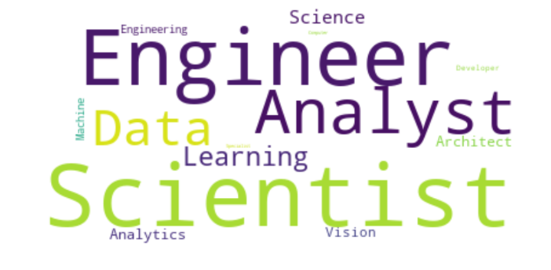

Slide 10
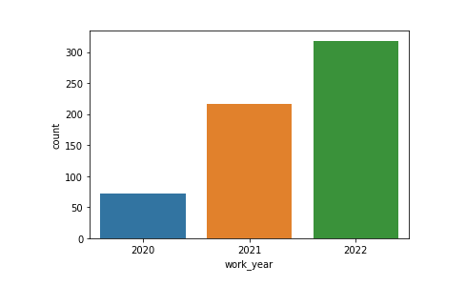

Slide 11
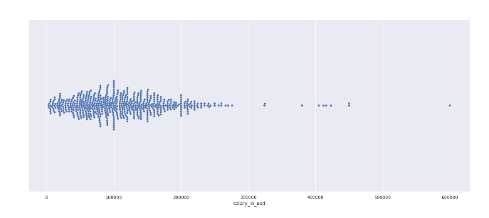

Slide 12
CONCLUSION
Findings
Summarize model performance and discuss the importance of accurate salary predictions in hiring.

Slide 13
FUTURE SCOPE
Enhancements
Include more job-related features for better predictions.
Expand the model to cover different industries and job markets.

Slide 14
REFERENCES
Sources
Include relevant research papers and articles on deep learning and salary prediction.
This example demonstrates how to build and deploy a salary prediction system using deep learning techniques, which can be adapted to other predictive modeling tasks.

Slide 15
thank you

